Slide 1

Library Management
System
The Code Ninjas

Slide 2
Table of Contents
Introduction
Functions
How and why
Advantages and Disadvantages
Source file
A program that runs and
gives output
Conclusion

Slide 3

Introduction
Insertion sort is a simple sorting algorithm that works by repeatedly taking one element from an unsorted list and inserting it in to its correct position within a sorted portion of the list.
The insertion sort algorithm enhances the sorting functionality within the library management system
Objective is to improve the efficiency of sorting books, making it easier for users to discover and access library resources
The aim is to construct a library management system in which books will be arranged in ascending order according to the year of publication using insertion sorts to make it easier for students to locate books.

Slide 4
Functions
User Authentication
Book Information Entry
Insertion Sort
Sound Feedback
User Interface

Slide 5

How and…
It prompts the user to enter their work ID and password to access the system
It uses arrays to hold Work IDs and Passwords
The system uses a vector function to store book information
An Insertion Sort algorithm is implemented to sort books by their publication years.

Slide 6
Why
The user authentication feature is crucial. It makes sure that only authorized users, like librarians, can add books to the catalogue or access particular library resources.
It speed up user authentication, making it possible to verify user credentials.
To make it simpler for users to find books of interest according to years of publication.

Slide 7

Advantages
User Authentication
- The program's code implements a straightforward user authentication method that permits authorized users to access it while prohibiting access from others.
Book Data Entry - It enables users to enter information on books, such as the title, author, genre, and year of publication, and then stores this data in a vector.

Slide 8
Advantages
Sorting Functionality - The code includes a mechanism for sorting (insertion sort) to keep the list of books in chronological order.
Simplicity - The C++ code is understandable and is a wonderful teaching tool, especially for those learning about vectors, classes, and the fundamentals of user interaction.
Stable Sorting - The code's usage of insertion sort, a stable sorting method that maintains the relative order of equal elements, can be advantageous in some circumstances.

Slide 9

Disadvantage
Limited User Authentication - The user authentication process is quite simple and is insufficient for real-world security. It employs unsafe hard-coded arrays for work IDs and passwords. In actuality, a stronger authentication technique would be necessary.
Lack of Error Handling - Robust error management and user input validation are lacking in the code. For instance, it doesn't look for edge situations or erroneous input data that can result in software crashes.

Slide 10
Disadvantage
Insufficient Algorithm - Despite being straightforward, insertion sort is not the best sorting technique for larger datasets. With many books, it may perform poorly because to its average and worst-case time complexity of O(n ^2).
Limited User Interaction - Other than authentication and book insertion, the code seldom ever interacts with the user. Its practical utility is constrained by the absence of menu options or search or modification functionality for books.

Slide 11

Source Code File

Slide 12
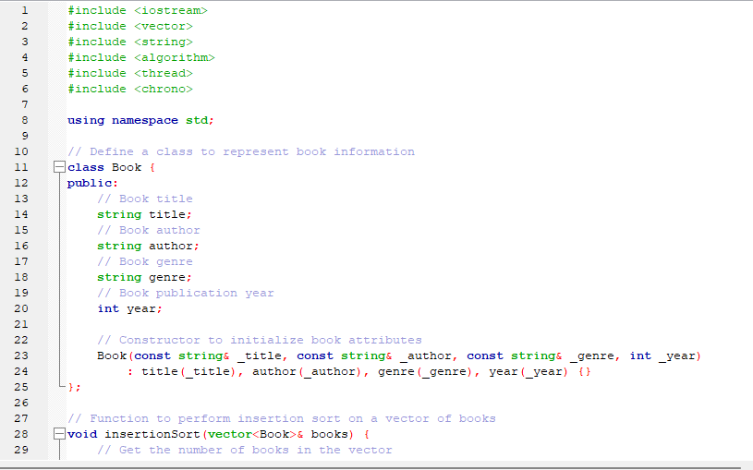
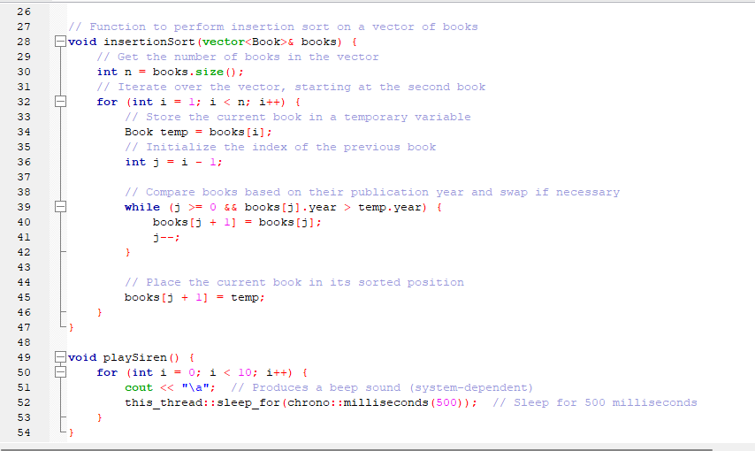
Insertion Sort Program

Slide 13
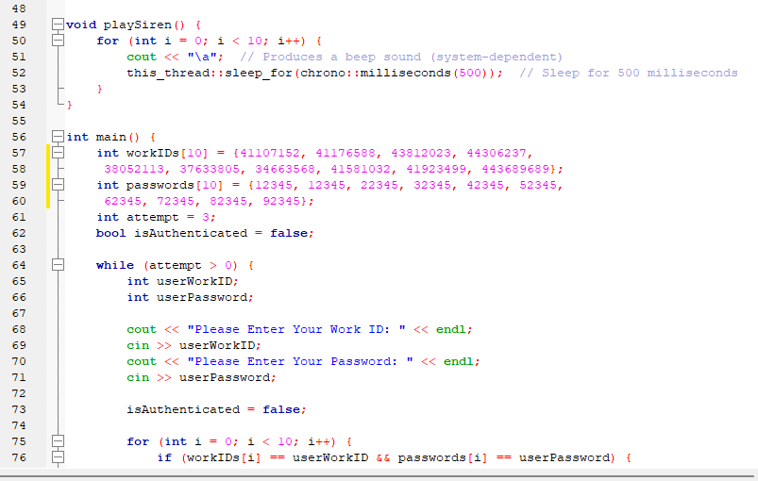
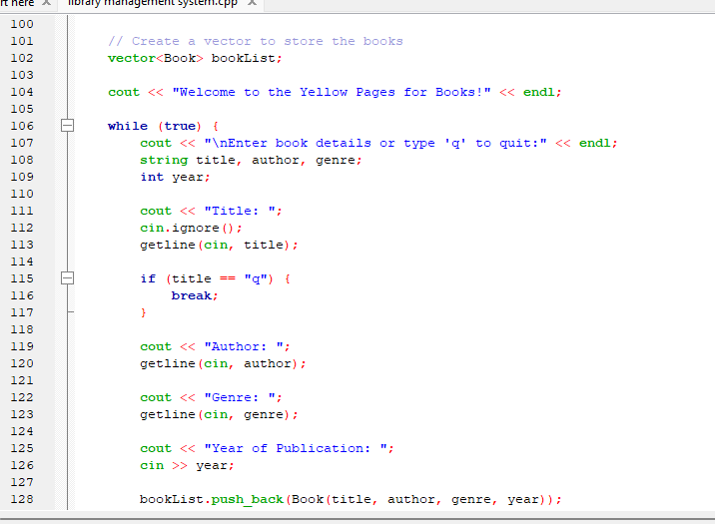
Insertion Sort Program

Slide 14
In summary, the provided C++ code creates a straightforward program that combines user identification, book data entering, and insertion sorting to arrange books according to their publication year. A simple educational example for user authentication and sorting book data is provided by this code, but it falls short in terms of security, error management, and other aspects that are anticipated in a production-ready application. Additional improvements and durable features would be required for practical use or future development.
Conclusion
.

Slide 15

Reference List
.
Malik, D.S, 6th ed. 2013. C++ Programming from Problem Analysis to Program Design. Boston, MA: Nelson Education.

